Slide 1
Multimedia Database

Slide 2
Multimedia Database Systems
Multimedia Database Systems are database systems where, besides text and other discrete data, audio and video information will also be stored, manipulated and retrieved.
MM Database

Slide 3
What is a Multimedia DBMS?
A multimedia database management system (MM-DBMS) is a framework that manages different types of data potentially represented in a wide diversity of formats on a wide array of media sources.
Like the traditional DBMS, MM-DBMS should address requirements:
  Integration
    Data items do not need to be duplicated for different programs
  Data independence
    Separate the database and the management from the application programs
  Concurrency control
    allows concurrent transactions
MM Database

Slide 4
Requirements of Multimedia DBMS
  Persistence
    Data objects can be saved and re-used by different transactions and program invocations
  Privacy
    Access and authorization control
  Integrity control
    Ensures database consistency between transactions
  Recovery
    Failures of transactions should not affect the persistent data storage
  Query support
    Allows easy querying of multimedia data
MM Database

Slide 5
Requirements of Multimedia DBMS (cont.)
In addition, an MM-DBMS should:
  have the ability to uniformly query data (media data, textual data) represented in different formats.
  have the ability to simultaneously query different media sources and conduct classical database operations across them.
  ⇒ query support
  have the ability to retrieve media objects from a local storage device in a smooth jitter-free (i.e. continuous) manner.
  ⇒ storage support
  have the ability to take the answer generated by a query and develop a presentation of that answer in terms of audio-visual media.
  have the ability to deliver this presentation in a way that satisfies various Quality of Service requirements.
  ⇒ presentation and delivery support
MM Database

Slide 6
Major Issues: Query Support
Allow easy query of multimedia data
  What is query by content?
  Can query be specified as a combination of media (examples) and text description?
  How to handle different MM objects?
  What query language should be used?
Allow efficient query of multimedia data
  What algorithms can be used to efficiently retrieve media data on the basis of similarity?
  How should we index the content of different MM objects?
How to provide traditional DBMS supports?
MM Database

Slide 7
Major Issues: Storage Support
How do the following (standard) storage devices work?
  disk systems
  CD-ROM systems
  tape systems and tape libraries
How is data laid out on such devices?
How do we design disk/CD-ROM/tape servers so as to optimally satisfy different clients concurrently when these clients execute the following operations
  playback
  rewind
  fast forward
  pause
MM Database

Slide 8
Major Issues:
Presentation & Delivery Support
How do we specify the content of multimedia presentations?
How do we specify the form (temporal/spatial layout) of this content?
How do we create a presentation schedule that satisfies these temporal/spatial presentation requirements?
How can we deliver a multimedia presentation to users when there is
  a need to interact with other remote servers to assemble the presentation (or parts of it)
  a bound on the buffer, bandwidth, load, and other resources available on the system
  a mismatch between the host server's capabilities and the customers machine capabilities?
How can such presentations optimize Quality of Service (QoS)?
MM Database

Slide 9
A Sample Multimedia Scenario
Consider a police investigation of a large-scale drug operation. This investigation may generate the following types of data
  Video data captured by surveillance cameras that record the activities taking place at various locations.
  Audio data captured by legally authorized telephone wiretaps.
  Image data consisting of still photographs taken by investigators.
  Document data seized by the police when raiding one or more places.
  Structured relational data containing background information, back records, etc., of the suspects involved.
  Geographic information system data remaining geographic data relevant to the drug investigation being conducted.
MM Database

Slide 10
Possible Queries
Image Query (by example):
Police officer Rocky has a photograph in front of him.
He wants to find the identity of the person in the picture.
Query: “Retrieve all images from the image library in which the person appearing in the (currently displayed) photograph appears”
Image Query (by keywords):
Police officer Rocky wants to examine pictures of “Big Spender”.
Query: "Retrieve all images from the image library in which “Big Spender” appears."
MM Database

Slide 11
Possible Queries (cont.)
Video Query:
Police officer Rocky is examining a surveillance video of a particular person being fatally assaulted by an assailant. However, the assailant's face is occluded and image processing algorithms return very poor matches. Rocky thinks the assault was by someone known to the victim.
Query: “Find all video segments in which the victim of the assault appears.”
By examining the answer of the above query, Rocky hopes to find other people who have previously interacted with the victim.
Heterogeneous Multimedia Query:
Find all individuals who have been photographed with “Big Spender” and who have been convicted of attempted murder in South China and who have recently had electronic fund transfers made into their bank accounts from ABC Corp.
MM Database

Slide 12
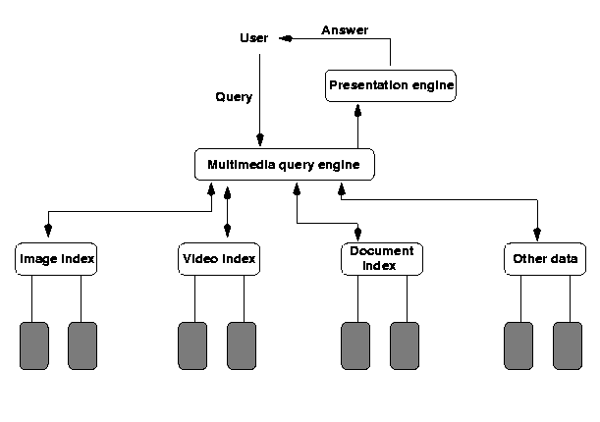
MM Database Architectures
Based on Principle of Autonomy
Each media type is organized in a media-specific manner suitable for that media type
Need to compute joins across
different data structures
Relatively fast query
processing due to
specialized structures
The only choice for legacy
data banks
MM Database

Slide 13
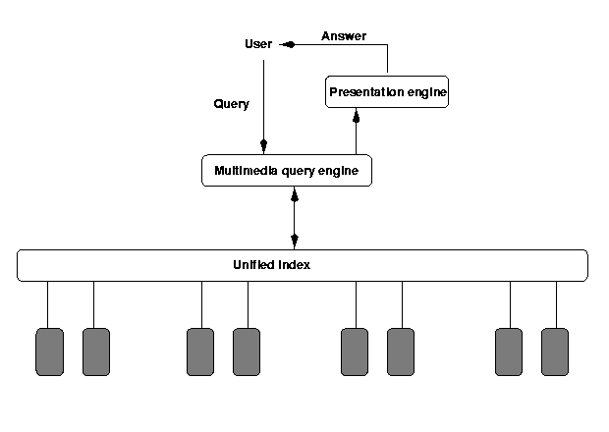
MM Database Architectures (cont.)
Based on Principle of Uniformity
A single abstract structure to index all media types
Abstract out the common part of different media types (difficult!) - metadata
One structure - easy implementation
Annotations for different
media types
MM Database

Slide 14
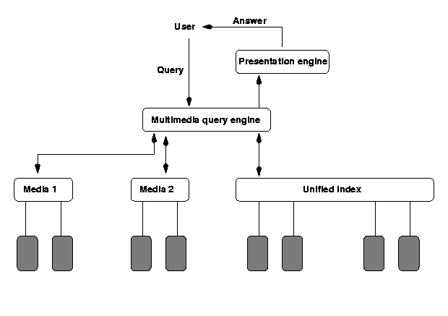
MM Database Architectures (cont.)
Based on Principle of Hybrid Organization
A hybrid of the first two. Certain media types use their own indexes, while others use the "unified" index
An attempt to capture
the advantages of the
first two
Joins across multiple
data sources using their
native indexes
MM Database

Slide 15
Organizing Multimedia Data Based on the
Principle of Uniformity
Consider the following statements about media data and they may be made by a human or may be produced by the output of an image/video/text content retrieval engine.
  The image photol.gif shows Jane Shady, “Big Spender” and an unidentified third person, in Sheung Shui. The picture was taken on January 5, 1997.
  The video-clip videol.mpg shows Jane Shady giving “Big Spender” a briefcase (in frames 50-100). The video was obtained from surveillance set up at Big Spender’s house in Kowloon Tong, in October, 1996.
  The document bigspender.txt contains background information on Big Spender, a police’s file.
MM Database

Slide 16
Metadata and Media Abstraction
All these statements are Meta-data statements.
  Associate, with each media object o_{i}, some meta-data, md(o_{i})
  If our archive contains objects o₁,..., o_{n}, then index the meta data md(o₁),..., md(o_{n}) in a way that provides efficient ways of implementing the expected accesses that users will make.
We expect to take use of a single data structure to represent metadata
This can be achieved via media abstractions
Media abstractions are mathematical structure representing such media content.
Let’s consider a simple multimedia database system (SMDS) hereafter!
MM Database

Slide 17
Querying SMDSs (Uniform Representation)
Querying SMDS based on top of SQL. Basic functions include:
FindType(Obj): This function takes a media object Obj as input, and returns the output type of the object. For example,
  FindType(iml.gif) = gif.
  FindType(moviel.mpg) = mpg.
FindObjWithFeature(f): This function takes a feature f as input and returns as output, the set of all media objects that contain that feature. For example,
FindObjWithFeature(john)= {iml.gif,im2.gif,im3.gif,videol.mpg:[1,5]}. FindObjWithFeature(mary)= {videol.mpg:[1,5],videol.mpg:[15,50]}.
MM Database

Slide 18
Querying SMDSs (Uniform Representation) (cont.)
FindObjWithFeatureandAttr(f,a,v): This function takes as input, a feature f, an attribute name a associated with that feature, and a value v. It returns as output, all objects obj that contain the feature and such the value of the attribute a in object obj is v. E.g.
  FindObjWithFeatureandAttr(Big Spender,suit,blue): This query asks to find all media objects in which Big Spender appears in a blue suit.
FindFeaturesinObj(Obj): This query asks to find all features that occur within a given media object. It returns as output, the set of all such features. For example,
  FindFeaturesinObj (iml.gif): This asks for all features within the image file iml.gif. It may return as output, the objects John, and Lisa.
  FindFeaturesinObj(videol.mpg:[1,15]): This asks for all features within the first 15 frames of the video file videol.mpg. The answer may include objects such as Mary and John.
MM Database

Slide 19
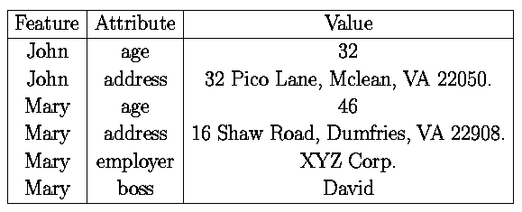
Querying SMDSs (Uniform Representation) (cont.)
FindFeaturesandAttrinObj(Obj): This query is exactly like the previous query except that it returns as output, a relation having the scheme
  (Feature,Attribute,Value)
where the triple (f,a,v) occurs in the output relation iff feature f occurs in the query FindFeaturesinObj(Obj) and feature f's attribute a is defined and has value v. For example,
  FindFeaturesandAttrinObj(iml.gif) may return as answer, the table
MM Database

Slide 20
Querying SMDS by SMDS-SQL
All ordinary SQL statements are SMDS-SQL statements. In addition:
The SELECT statement may contain media-entities. A media entity is defined as follows:
  If m is a continuous media object, and i, j are integers, then m:[i, j] is a media-entity denoting the set of all frames of media object m that lie between (and inclusive of) segments i, j.
  If m is not a continuous media object, then m is a media entity.
  If m is a media entity, and a is an attribute of m, then m.a is a media-entity.
The FROM statement may contain entries of the form
<media> <source> <M>
which says that only media-objects associate with the named media type and named data source are to be considered when processing the query, and that M is a variable ranging over such media objects.
MM Database

Slide 21
Querying SMDS by SMDS-SQL (cont)
The WHERE statement allows (in addition to standard SQL constructs), expressions of the form
term IN func_ca11
where
  term is either a variable (in which case it ranges over the output type of func_call) or an object having the same output type as func_call and
  func_call is any of the five function calls stated above
MM Database

Slide 22
Sample SMDS-SQL Statements
Find all image/video objects containing both Jane Shady and Big Spender. This can be expressed as the SMDS-SQL query:
SELECT M
FROM smds source1 M
WHERE (FindType(M)=Video OR FindType(M)=Image)
AND
M IN FindObjWithFeature(Big Spender)
AND
M IN FindObjWithFeature(Jane Shady).
MM Database

Slide 23
Sample SMDS-SQL Statements (cont.)
Find all image/video objects containing Big Spender wearing a purple suit. This can be expressed as the SMDS-SQL query:
SELECT M
FROM smds sourcel M
WHERE (FindType(M)=Video OR FindType(M)=Image)
AND
M IN FindObjWithFeatureandAttr(Big Spender, suit, purple)
MM Database

